Slide 1
Spring Framework
Overview of Spring Framework

Slide 2
Agenda
What is Framework
Advantages of Framework
Disadvantages of Framework
Spring Framework

Slide 3
What is Framework?
A reusable software environment.
It may include support programs, compilers, code libraries, tool sets, and API
A framework can be extended by the user usually by selective overriding or specialized by user code to provide specific functionality.

Slide 4
Advantages of Frameworks
Reduces the time and energy in developing any software.
Framework separates business logic from user interface making the code cleaner and extensible.
Follow layered architecture and design patterns.
Tested
Implementation of low level services are easy.

Slide 5
Disadvantages of Framework
You learn the framework, not the language
Limitation

Slide 6
Spring Framework
The Spring Framework is a Java platform that provides comprehensive infrastructure support for developing Java applications.
Spring handles the infrastructure so you can focus on your application
Lightweight solution a potential one-stop-shop for building your enterprise-ready applications.
Spring is modular
allowing you to use only those parts that you need, without having to bring in the rest.

Slide 7
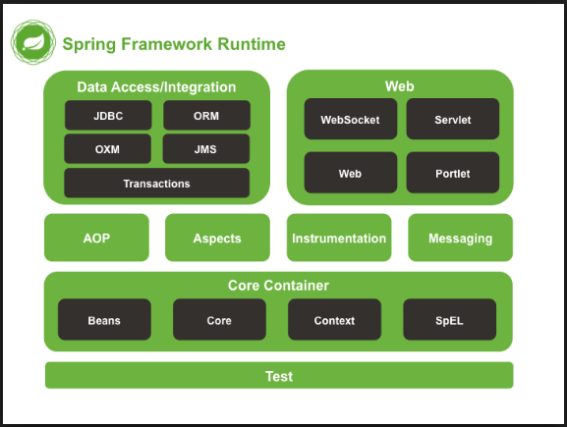
Modules

Slide 8
Core Container
The Core Container consists of
spring-core
spring-beans
spring-context and spring- context-support
spring-expression (Spring Expression Language) modules.

Slide 9
spring-core and spring-beans
The spring-core and spring-beans modules
provide the fundamental parts of the framework, including the
IoC
and
Dependency Injection features

Slide 10
spring-context
The Context (spring-context) module provides a mechanism to access objects in a framework-style manner that is similar to a JNDI registry.
Example
context.getBean(“product");

Slide 11
spring-expression
The spring-expression module provides a Language for querying and manipulating an object graph at runtime.
The language supports
setting and getting property values
property assignment etc.,

Slide 12
Modules

Slide 13
spring-aop
The spring-aop module provides an AOP Alliance-compliant aspect-oriented programming implementation allowing you to define, for example,
method interceptors and
pointcuts to
cleanly decouple code that implements functionality that should be separated.

Slide 14
spring-instrument
The spring-instrument module provides
class instrumentation support and
classloader implementations to be used in certain application servers.
Ex :
The spring-instrument-tomcat module contains Spring’s instrumentation agent for Tomcat.

Slide 15
spring-messaging
spring-messaging module with key abstractions from the Spring Integration project such as
Message,
MessageChannel,
MessageHandler,
and others to serve as a foundation for messaging-based applications.

Slide 16
Data Access/Integratio

Slide 17
spring-jdbc
The spring-jdbc module provides a JDBC-abstraction layer that removes the need to do tedious JDBC coding and parsing of database-vendor specific error codes.

Slide 18
spring-tx
The spring-tx module supports programmatic and declarative transaction management for classes that implement special interfaces and for all your POJOs (Plain Old Java Objects).

Slide 19
spring-orm
The spring-orm module provides integration layers for popular object-relational mapping APIs, including JPA and Hibernate.

Slide 20
spring-oxm
The spring-oxm module provides an abstraction layer that supports Object/XML mapping implementations such as JAXB, Castor, XMLBeans, JiBX and XStream.

Slide 21
spring-jms
The spring-jms module (Java Messaging Service) contains features for producing and consuming messages.

Slide 22
Web module

Slide 23
spring-web
The spring-web module provides basic web-oriented integration features such as
multipart file upload functionality and
initialization of
IoC container and
web-oriented application context.
It also contains an HTTP client and the web-related parts of Spring’s remoting support.

Slide 24
spring-webmvc
The spring-webmvc module contains
Spring’s model- view-controller (MVC) and
REST Web Services implementation for web applications.
Also known as the Web-Servlet module

Slide 25
spring-webmvc-portlet
The spring-webmvc-portlet module provides the MVC implementation to be used in a Portlet environment and mirrors the functionality of the spring-webmvc module.

Slide 26
websocket
A new spring-websocket module provides comprehensive support for WebSocket-based, two-way communication between client and server in web applications.

Slide 27
Modules

Slide 28
spring-test
The spring-test module supports the unit testing and integration testing of Spring components with JUnit or TestNG.
It provides consistent loading of Spring ApplicationContexts and caching of those contexts.
It also provides mock objects that you can use to test your code in isolation.

